Slide 2
Average Lifespan Over Time:
1900: 47 years
2022: 77.5 years
Increase: +30.5 years over 120+ years (~0.25 years per year)

Slide 3
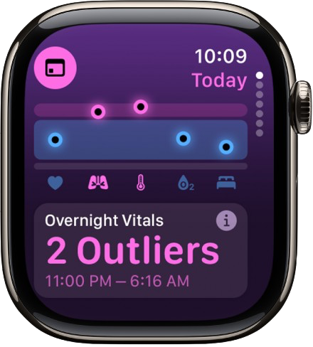
Smart watches are filled with health metrics to keep you in the know. You can monitor your heart rate, respiratory rate, blood oxygen levels and sleep duration.

Slide 4
Oura rings provide wearable technology designed to track heart rate, stress levels, sleep stages and potential indicators of illness. This data may support personalized health insights and wellness monitoring.

Slide 5
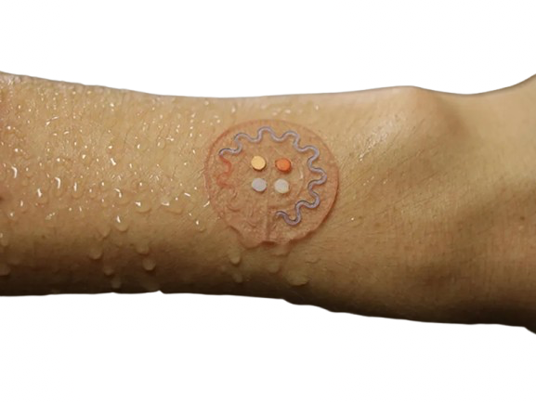
Microfluidic patches enable noninvasive, real-time sweat analysis, offering insights into hydration, glucose levels, stress and other biomarkers. This technology has potential applications in early detection and personalized healthcare.

Slide 6
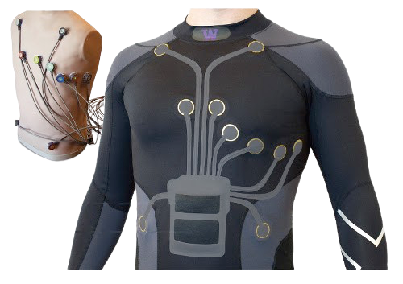
Electronic textiles are smart clothing embedded with sensors that can track heart rate, respiration, posture, and even muscle activity — all while looking and feeling like regular fabric!

Slide 7
Technology like the Withings BeamO can help families track their health more quickly. With a thermometer, stethoscope, electrocardiogram, and pulse oximeter all in one!

Slide 8
Pharmacogenomics is the science of how your genes affect your response to medications. It helps doctors choose the right drug at the right dose — reducing side effects and making treatments more effective.

Slide 9
Apps like Lumosity, Elevate, and Peak use games to help improve memory, focus, problem-solving, and more. They’re designed to keep your brain sharp as you age.

Slide 10
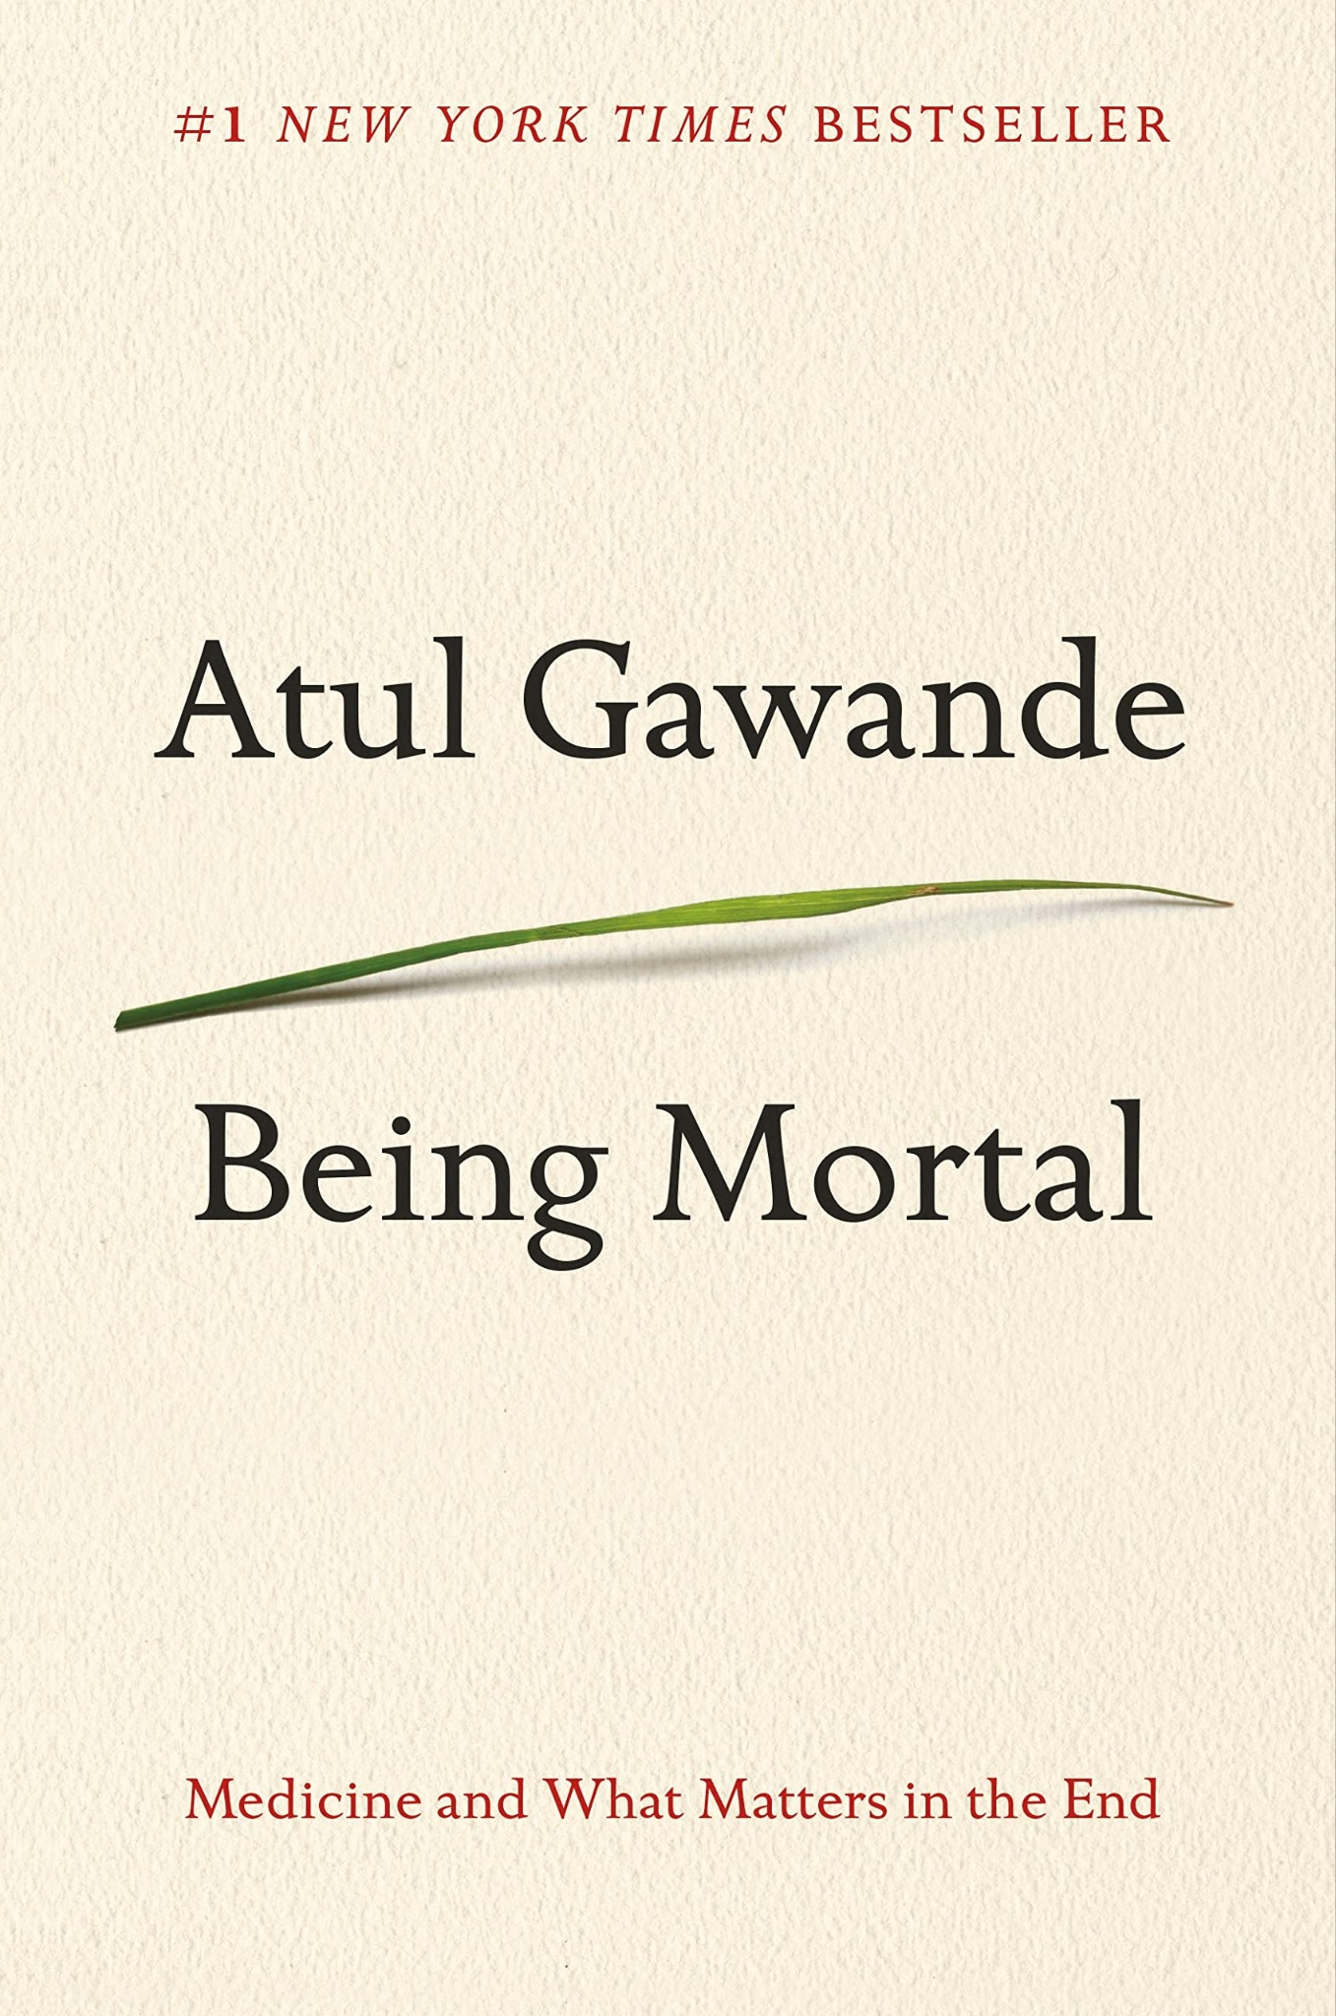
Being Mortal: Medicine and What Matters in the End
Atul Gawande
Recommended by Dr. Clay Marsh, Chancellor and Executive Dean for Health Sciences at West Virginia University
“Riveting, honest and humane, showing how the ultimate goal is not a good death but a good life—all the way to the very end.”

Slide 11
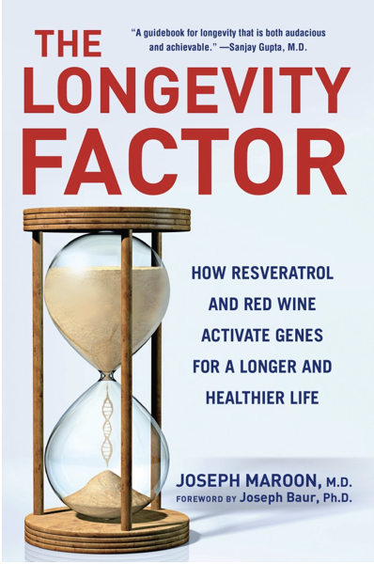
The Longevity Factor: How Resveratrol and Red Wine Activate Genes for a Longer, Healthier Life
Joseph Maroon, M.D.
“In The Longevity Factor, noted neuroscientist and surgeon Joseph Maroon, MD, offers the definitive look at recent scientific breakthroughs identifying a group of natural substances—including the much-publicized molecule resveratrol—that can actually activate a specific set of genes in humans that promote a longer, healthier life. These substances, which make red wine, dark chocolate, and green tea good for us, appear to stave off a wide array of age-related diseases and keep us feeling young and vital.”

Slide 12
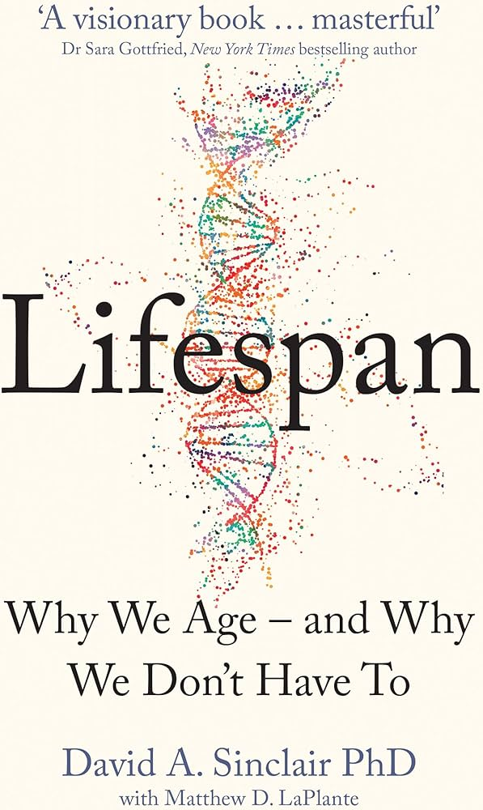
Lifespan: Why We Age - and Why We Don’t Have To
David A. Sinclair, Ph.D.
It’s a seemingly undeniable truth that aging is inevitable. But what if everything we’ve been taught to believe about aging is wrong? What if we could choose our lifespan?
In this groundbreaking book, Dr. David Sinclair, leading world authority on genetics and longevity, reveals a bold new theory for why we age. As he writes: “Aging is a disease, and that disease is treatable.”

Slide 13
Lifespan
With Dr. David Sinclair
Join Dr. David Sinclair, Ph.D. in Lifespan, a popular health podcast that brings the cutting edge of aging and longevity science straight to you. Hear about the latest developments in aging research, lifestyle practices for longevity, exercise and nutrition science, and more.
This podcast is distinct from Dr. Sinclair's teaching and research roles at Harvard Medical School. The information provided in this show is not medical advice, nor should it be taken or applied as a replacement for medical advice.

Slide 14
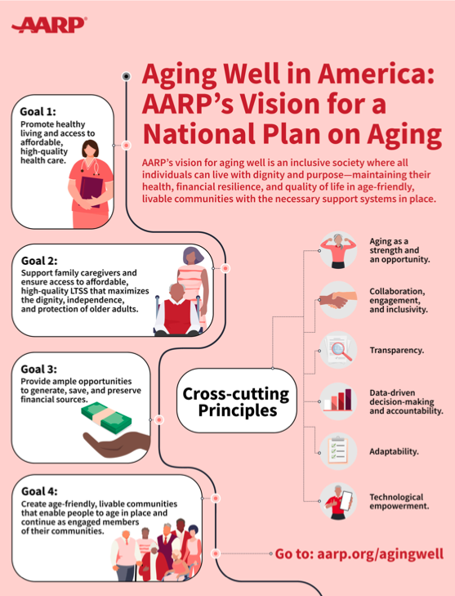
Aging Well in America:
AARP’s Plan on Aging
AARP’s vision for aging well is an inclusive society where all individuals can live with dignity and purpose- maintaining their health, financial resilience, and quality of life in age-friendly, livable communities with the necessary support system.

Slide 15
TED: What’s the secret to living longer?
A playlist of eight TED Talks focused on way to potentially prolong human life. Titles/topics include:
The secret to living longer may be your social life
How to live to be 100+
What makes a good life? Lessons from the longest study on happiness.
How societies can grow old better.

Slide 16
Square One: A Simple Guide to a Balanced Life
Dr. Joseph Maroon
After hitting rock bottom, world-renowned neurosurgeon Dr. Maroon rebuilt his life through four pillars: health, spirituality, purpose, and relationships.
In Square One, he shares his journey to balance, resilience, and renewed joy.

Slide 17
As we age, our vocal cords can thin and lose strength—leading to weaker or raspier voices.
Men may notice a higher pitch, while women’s voices may become lower due to hormonal changes.
Persistent or sudden voice changes? Time to check in with an ENT specialist.

Slide 18
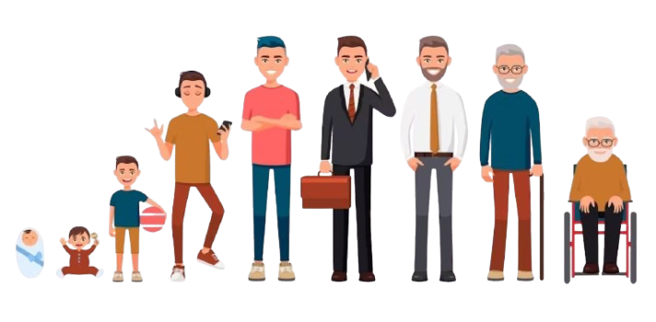
Starting around 40, most people lose height with age—about 1 inch for men and up to 2 inches for women by 70, and more after 80.
Why? Bone loss, weakened muscles, and spinal compression.
Stay active, eat well, and build your core to help slow it down!

Slide 19
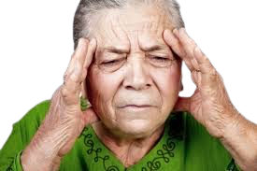
Good news for women: migraines often improve after menopause—becoming less frequent, less intense, or even disappearing altogether.
Symptoms may shift too, with fewer headaches and less nausea. Aging sometimes brings relief!

Slide 20
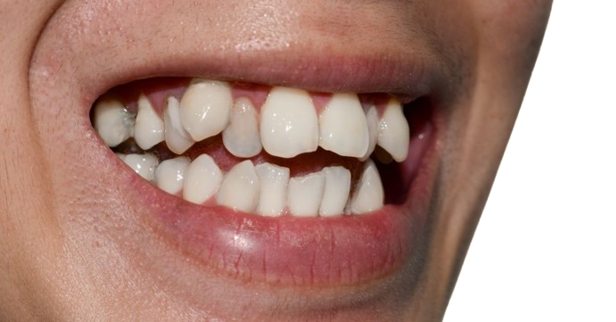
Even after braces, it’s common for lower teeth to become crooked with age.
Why? Tooth loss, gum disease, or years of grinding can cause them to “shift and drift,” especially on the bottom row.
Aging smiles come with a few curveballs!

